Slide 1
EE 188L
Lab #1 Resistors in Series and Parallel

Slide 2
Learning Outcomes
At the end of today’s lab, you will:
  Use the resistance color code to determine the nominal value of any resistor
  Use the Digital Multimeter (DMM) to measure resistance
  Determine and use the interconnection scheme of the ProtoBoard to make simple circuits
  Calculate and measure equivalent resistance for a variety of resistive networks
  Describe how equivalent resistance changes when you put resistors in series, or in parallel
  Trace current flow paths through circuits
  Determine how to create circuits with maximum and minimum resistance

Slide 3
Activity 1
Determining resistance of four resistors using the the color code and the Digital Multimeter
  This activity introduces you to the resistor color coding scheme
  Notice that resistors do not always have the exact value that they should
  Always measure resistors before using them in a circuit so that you are sure they are the value you want

Slide 4
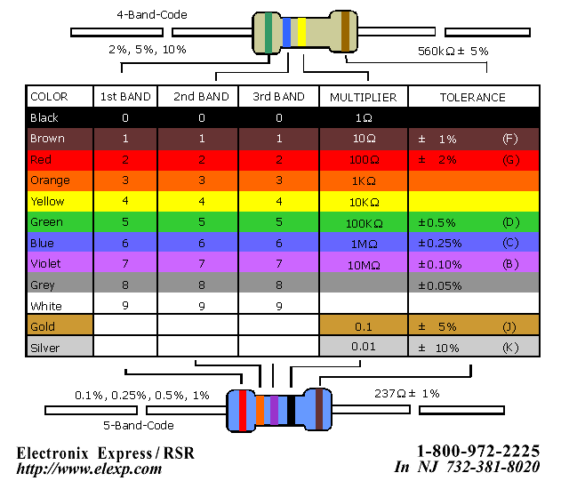
Resistor Color Code
56 · 10 kΩ = 560 kΩ ± 5%
237 · 1 Ω = 237 Ω ± 1%
http://www.elexp.com/t_resist.htm

Slide 5
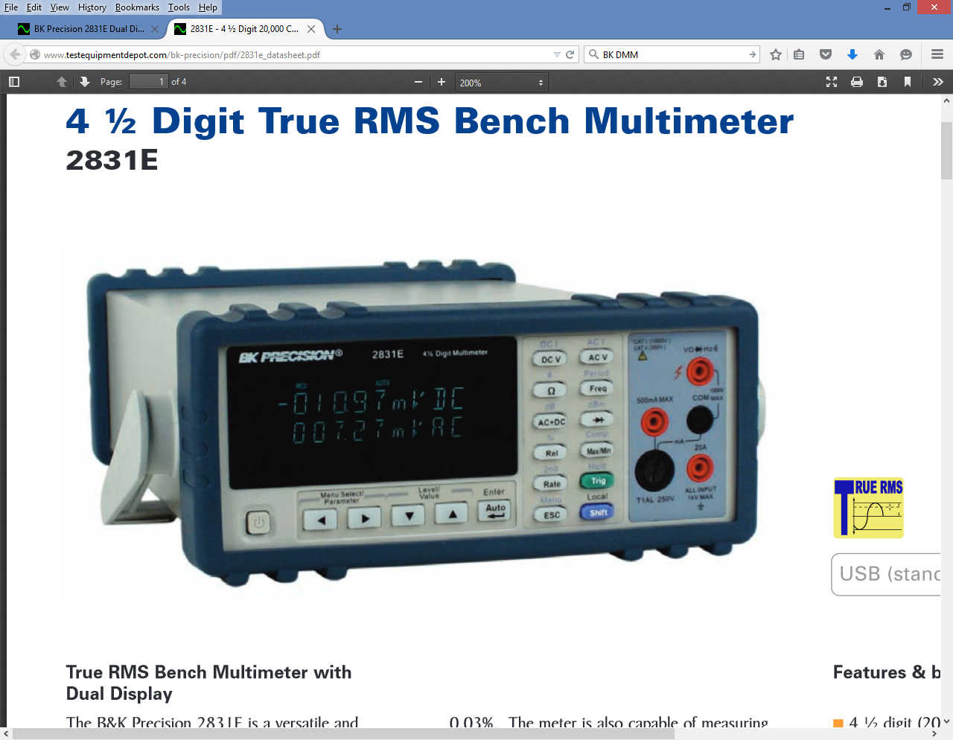
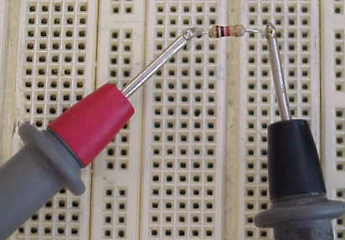
Measuring Resistance with the BK 2831E DMM
1. Red & black probes are in the plugs shown
2. Make sure the button with Ω is pressed
3. Place red and black probes on each side of a resistor
4. Read value of resistance on display and note the units

Slide 6
Activity 2 – Measure ProtoBoard Supply Voltages
Use the DMM to measure the three DC power supplies built into the ProtoBoard. You should measure the voltage difference between one red terminal and the black reference terminal.
When you connect a circuit to the ProtoBoard supplies, connect one end to one of the red terminals and the other end to the black reference terminal. Try not to use wires to make connections between resistors, but use the connections built into the ProtoBoard.

Slide 7
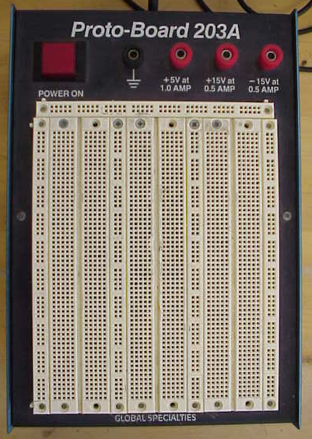
Protoboard
Good for making prototype
circuits
Note: POWER ON button
3 power supplies
+5, +15 and -15 volts
White grid
Holds devices
Makes connections
Some made underneath
Some made with wires you add

Slide 8
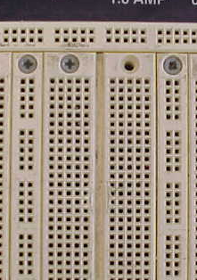
Protoboard Connections
Connections underneath:
Long rows across the top are
Connected, but not to anything else
Each row of 5 is connected
but not to anything else
Each column is connected
but not to anything else

Slide 9
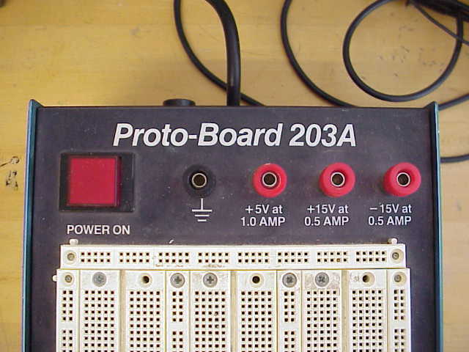
Protoboard Power Supplies
3 power supplies with common
ground
Shows maximum current available
Your circuit must connect to both the
black ground terminal and one
red terminal
Do not short terminals together!
Note fuse on side.

Slide 10
Measuring DC Voltage
1. Red and Black probes plugged into correct positions shown
2. Press the DC V button to measure DC voltage
3. Place red and black probes on two nodes
4. Read value of voltage displayed and note the units
Red probe
Black probe
Note 5.06 has 3 significant figures and 5.064 has 4 significant figures.

Slide 11
Activity 3 – Calculate Req
Calculate the equivalent resistance (Req) for each of the circuits.
For resistors in series, you add them together to get the Req
For resistors in parallel, you can add their reciprocals together to get 1/Req. In the case of two resistors, Req is the product of the two resistors over the sum.

Slide 12
Activity 3 – Calculate Req
First combine resistors that are in series (series is when all the current that goes through one goes through the other)
Then combine all the resistors in parallel (parallel is when the resistors all have the same voltage across them and they are connected together at each end)
After replacing each combination with an equivalent resistor, continue combining until you get to one resistor

Slide 13
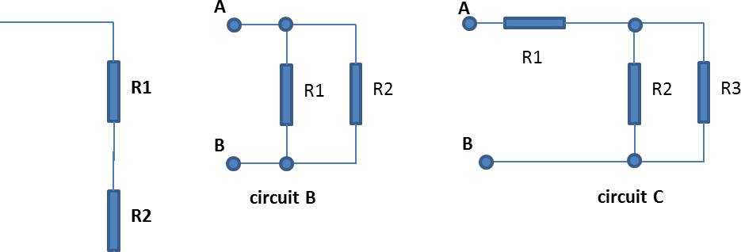
Activity 3 – Calculate Req
In this example, R1 is not in series with either R2 or R3, but R2 and R3 are in parallel with each other
The Req(R2||R3) for the parallel combination of R2 and R3 is Req(R2||R3) = R2∙R3/(R2+R3)
Now R1 and Req are in series
And can be added together to get Req(circuit C)
Req(R2||R3)
Req(circuit C)

Slide 14
Activity 3 – Build Circuits and Measure Req
Use the ProtoBoard to build each circuit. Try not to use wires, but use the connections built into the ProtoBoard. See the next slide for an example of how to build circuit C.

Slide 15
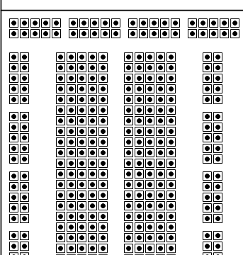
Circuit C for Activity 3
Connect 1st resistor to
two different sets of holes.
Connect the 2nd resistor so
that one lead is connected
to the same set of 5 holes
as the 1st resistor.
Connect the 3rd resistor so
that its ends are connected
to the same set of 5 holes
as the 2nd resistor.
(This is circuit C)
A
B

Slide 16
Activity 3
For each circuit, measure the equivalent resistance just like you measured resistance for a single resistor, except you are measuring from point A to point B.
If your calculated and measured results don’t agree, then determine where a mistake was made.
Note: If there is no current going through a resistor, then that resistance does not affect the Req

Slide 17
Activity 3
Build the circuit with the maximum possible Req using your resistors. Draw the current path(s), calculate and measure Req, and measure the voltage across each resistor.
When measuring Req, disconnect the power supply from your circuits, because its internal resistance will affect your readings.
Build the circuit with the minimum possible equivalent resistance using your resistors and do the same as above.

